Slide 1
RAPTOR Progress 7/22/2014
Sam Kelly
Jeff Byers

Slide 2
Redesigned Pipeline
Removed old messy research code
Replaced with organized interfaces and classes
Now maintain commits in a local git repository stored on gp1
New modular design allows for easy configuration of the experiments that will be required for Plans A, B, and C
Training Data Generator:
Python/Blender (rendering script) → Java (image processing, covariance matrices) → annotation file
Training:
Java (training program) → training → neural network (Plan A) or data structure (Plan B)
Plan C: Java (search program) ↔ Python/Blender Pose Renderer

Slide 3
Redesigned Pipeline
Now uses Jblas for matrix operations and eigenvalue calculation (before used a slower, hand-coded solution)
Now uses Imgscalr for image resizing in Java instead of built-in libraries (faster, higher quality)
Still using Heaton Research's Encog for feed-forward ANNs
Training data generator now fully parallel – takes full advantage of all of gp1's cores when running

Slide 4
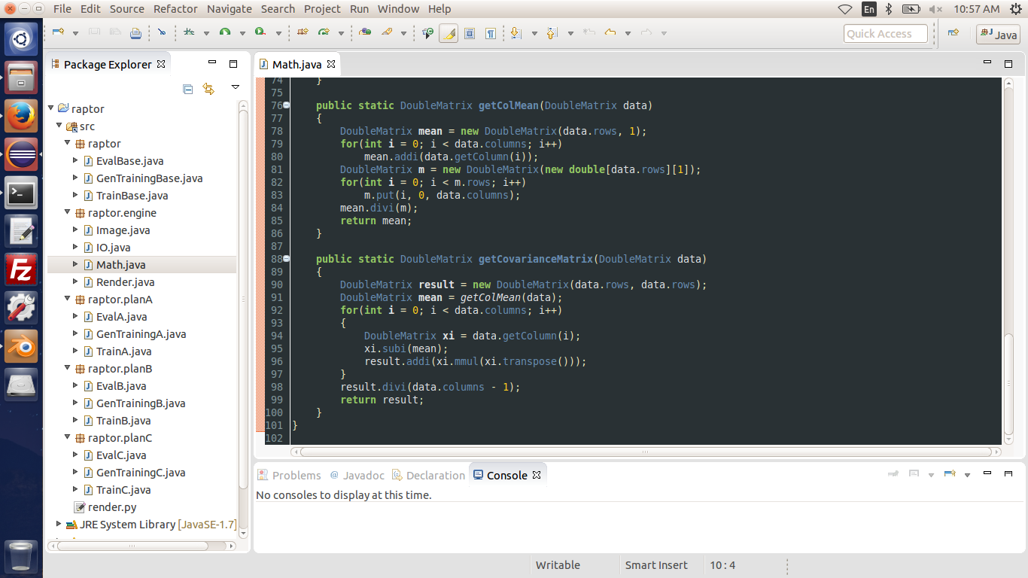
Redesigned Pipeline

Slide 5
Occlusion
Plans A and B both require finding a mapping between the 2 x 2 covariance matrix for a 2D image of a pose, and the 3 x 3 covariance matrix for the 3D point cloud of that same pose
Better correspondence between 2 x 2 and 3 x 3 matrices could be achieved if occluded vertices were excluded from our 3D point clouds
Might try to hook in to Blender's occlusion engine for this info, though this is proving difficult
A variation of the Painter's algorithm should be well-suited for this problem since we don't (shouldn't) have to worry about cyclic overlap or piercing polygons
  After z-ordering of faces is obtained from the Painter's algorithm, for each face, perform perspective projection on each vertex resulting in a 2D projected version of each face
  Next store all the polygons in a Polygonal Map Quadtree (Storing a Collection of Polygons Using Quadtrees, H Samet 1985)
  Now for each vertex in the model, find all polygons that intersect with that vertex using the polygonal map quadtree
  if any of these polygons is closer (based on Painter's algorithm output) to the viewport than the vertex, exclude this vertex
  Should be very efficient since we are not actually rendering the faces using this method – we are just finding which vertices are occluded, which is much simpler than the full occlusion problem faced in computational geometry and 3D rendering
  Should run in O(n*log(n)) time with a mild constant factor where n is the number of vertices

Slide 6
Subdivision
Subdividing the model so that there are more than one vertex on each edge might also improve correspondence between 2 x 2 and 3 x 3 covariance matrices
Model can easily be subdivided using a Blender routine exposed by the Python API
Will explore this

Slide 7
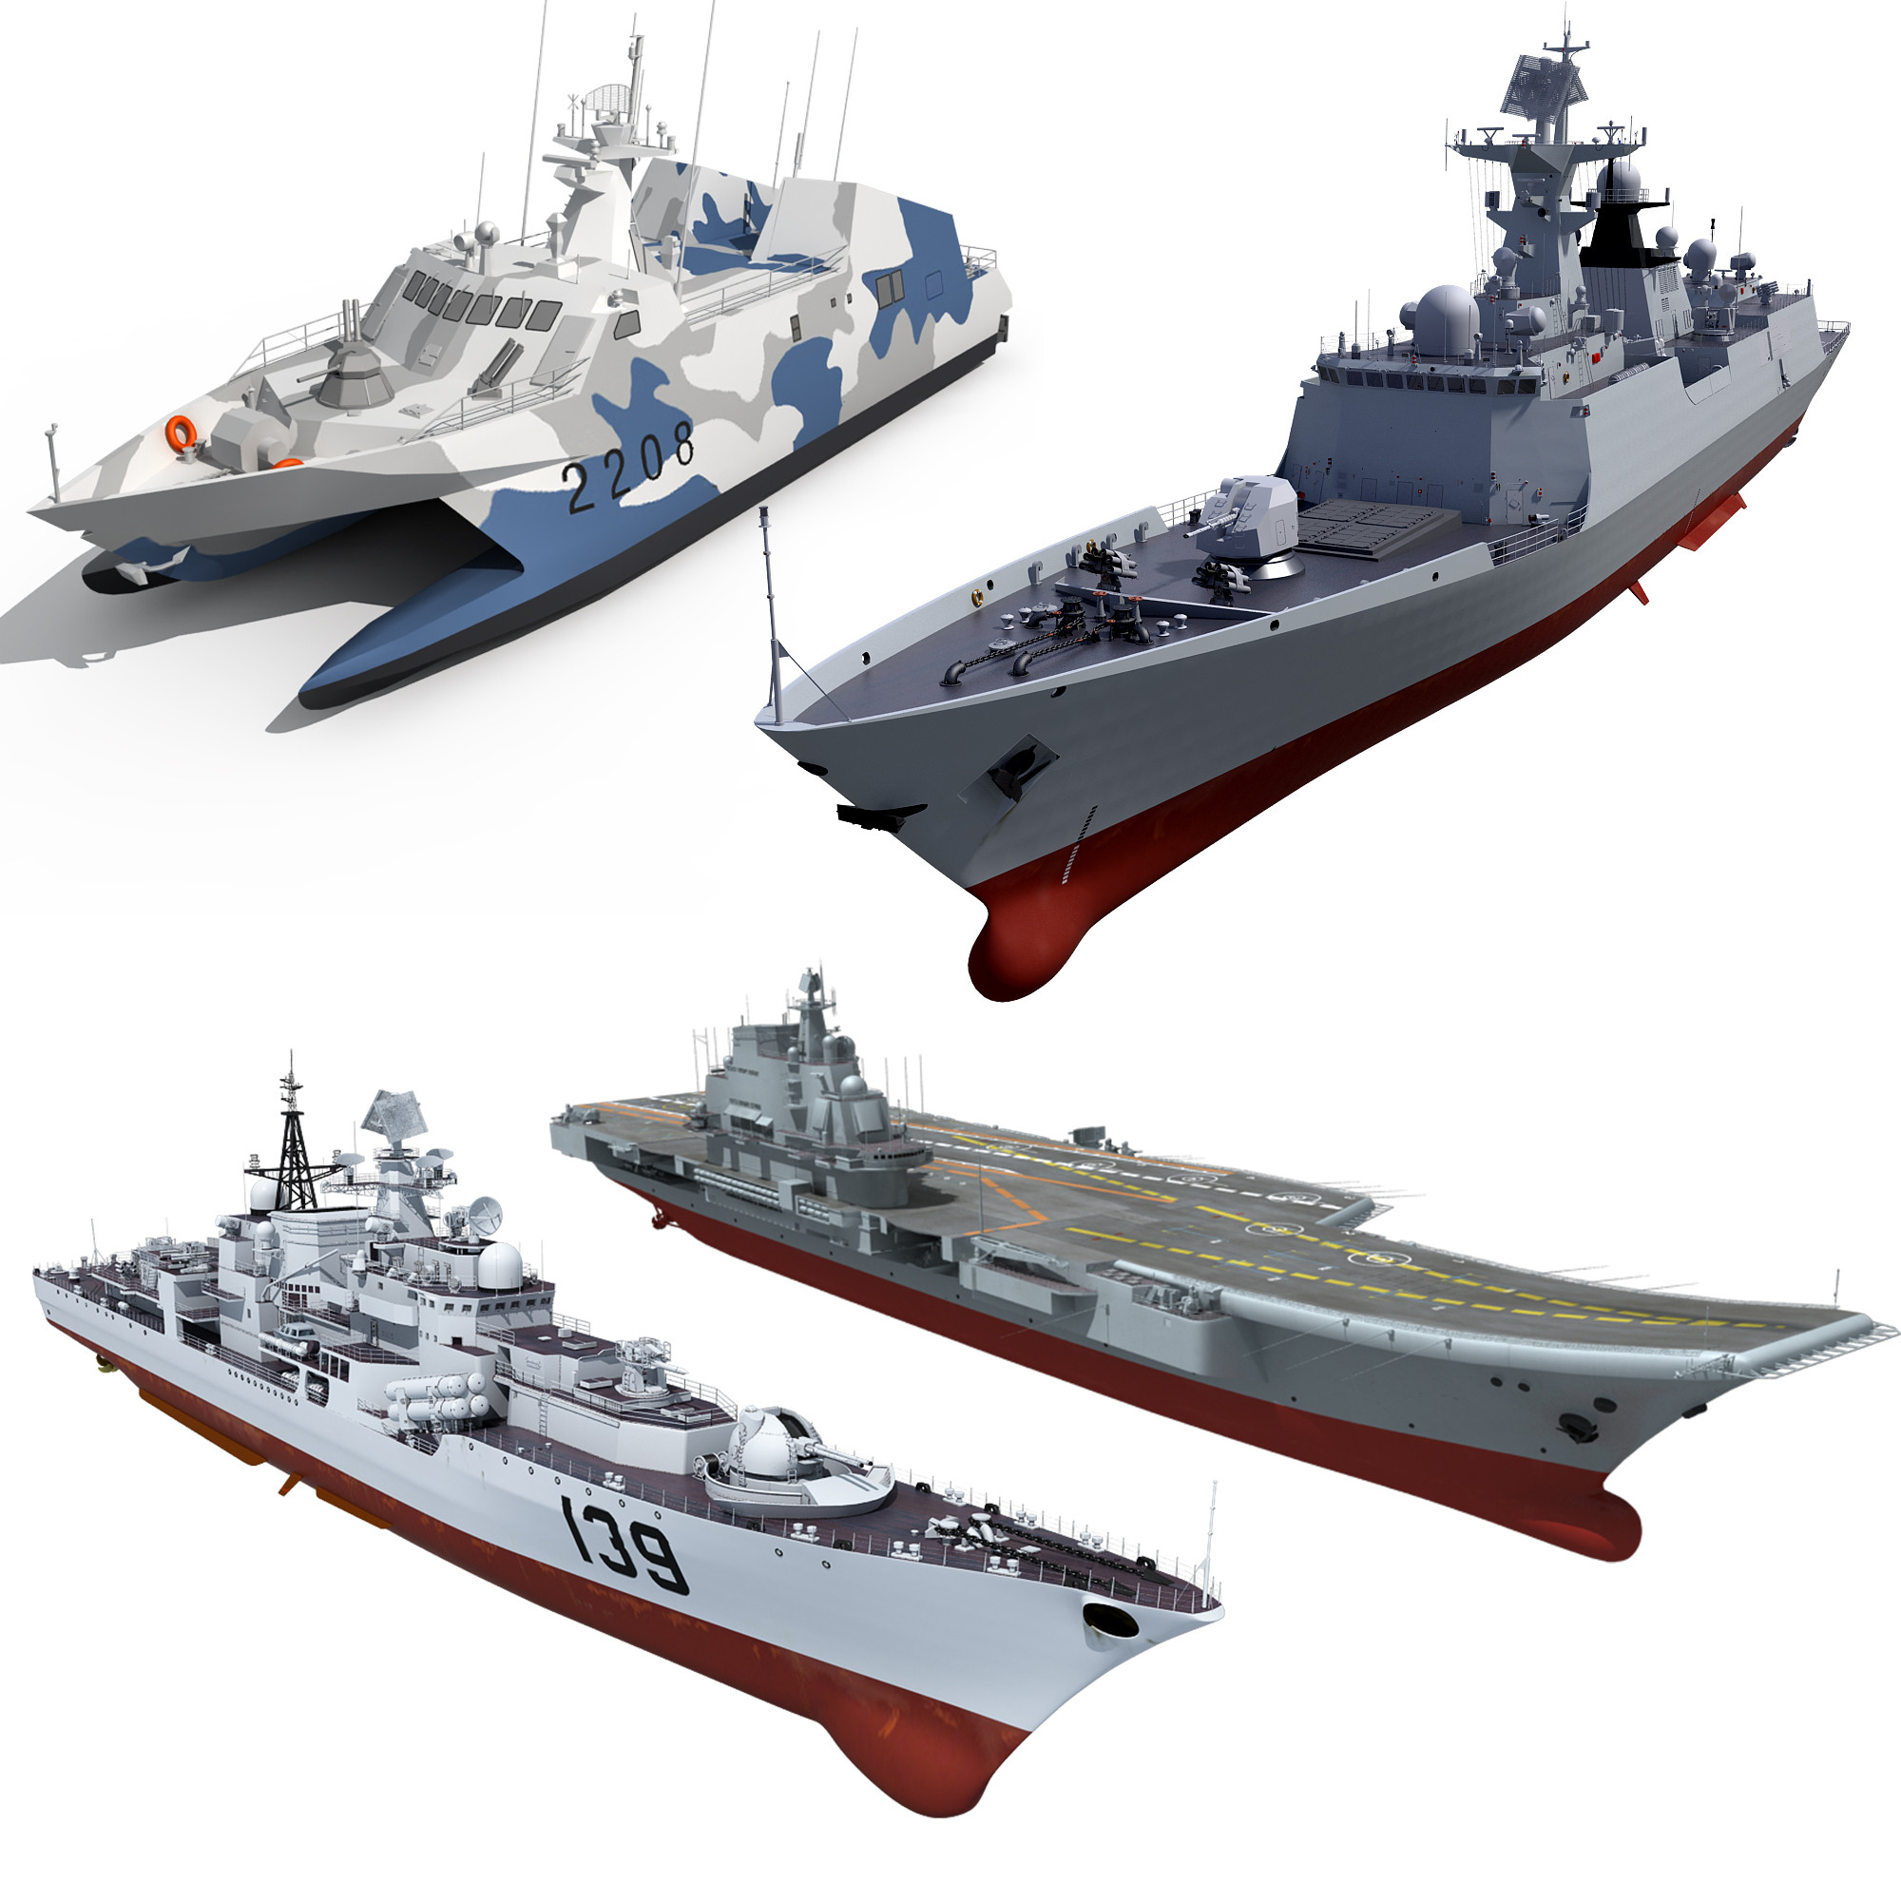
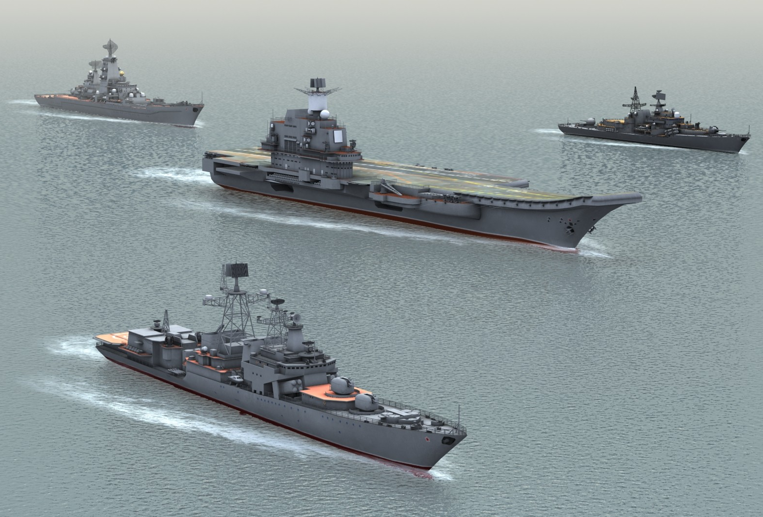
New 3D Ship Models
David has provided us with $1893 worth of high quality military ship models
Models are supposedly highly accurate, used by producers within the CG community (these are the same models used in movies, etc.)
Have models of Russian, Chinese, Canadian, and U.S. military vessels

Slide 8
Future Work
Plan to work remotely as a student contractor part time with NRL to continue this project for the next year while I'm in Baltimore (this is still preliminary / being worked on by David)
Barring that, plan to continue work on RAPTOR on my own
If we obtain good enough results, will try to publish a paper on this work
Will likely only have tentative results by the time my NREIP term ends, but definitely appropriate for a 10 week internship
Have only scratched the surface of what might be possible with this sort of model-driven approach to pose estimation

